Slide 1
Cell cycle and it’s regulation
Dr. B. M. Ndung’u
Lecturer, Dept of Human Anatomy
UoN

Slide 2
Objectives
To understand the processes and the phases of the cell cycle.
To appreciate the cellular events of each phase of the cell cycle.
Introduce the molecular basis of the phases of mitosis.
To appreciate the presence of cycle check-points and their role in carcinogenesis.

Slide 3
Cell Cycle
The cell cycle is an ordered set of events culminating in cell growth and division into two daughters cells.
Cell division is controlled by a highly regulated series of biochemical events - the cell division cycle (cdc).
The four coordinated processes of the cycle are:
Cell growth.
DNA replication.
Distribution of the duplicated chromosomes to daughter cells.

Slide 4
Cell Cycle Contd.
Cell division (cytokinesis).
Phases of the cycle.
Mitosis – nuclear division.
Interphase – time between consecutive mitosis.
The interphase consists of:
G1 (gap 1) phase.
Interval between mitosis and initiation of DNA replication.

Slide 5
Cell Cycle Contd.
Cell is metabolically active, exhibits continuous growth and prepares the chromosomes for replication.
S- (synthesis) phase.
Synthesis and replication of DNA and centrosomes – the microtubules organising centre.
G2 (gap 2) phase.
Protein synthesis.
Cell growth continues.

Slide 6
Cell Cycle Contd.
G0 (quiescent stage).
Cells are metabolically active but no longer proliferate unless stimulated by appropriate extracellular signals.
Not considered to be part of the cell cycle.

Slide 7
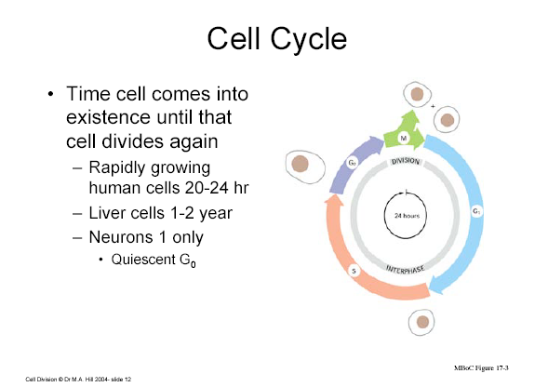

Slide 8
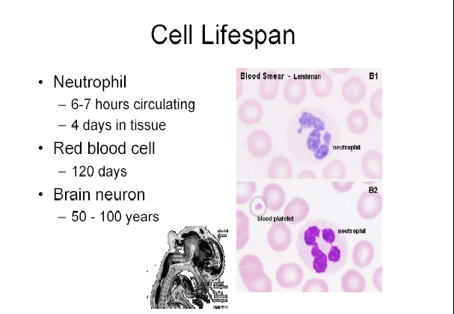

Slide 9
Regulation of the Cell Cycle
Critical for the normal development of multi-cellular organisms.
A breakdown/defect in the regulation leads to ‘out of control’ growth which ultimately leads to cancer.

Slide 10
Regulation of the Cell Cycle
Progression between cell cycle stages is controlled by conserved ‘regulatory apparatus’ which;
Coordinates the different events of the cycle.
Links the cycle with extra-cellular signals that control cell proliferation.
‘Regulatory apparatus’ are an interplay of many molecules.

Slide 11
Events of the Phases
Reasons for cell division;
Growth.
Repair and replacement of damaged parts.
Reproduction of species.

Slide 12
M-phase
Mitosis ; formation of identical daughters cells.
Basic events of mitosis.
Chromosomes condensation.
Formation of the mitotic spindle.
Attachment of chromosomes to the spindle.
Separation of sister chromatids and movement to the opposite poles of the spindle.
Formation of daughters nuclei.
Stages/ phases of mitosis- PMAT.

Slide 13
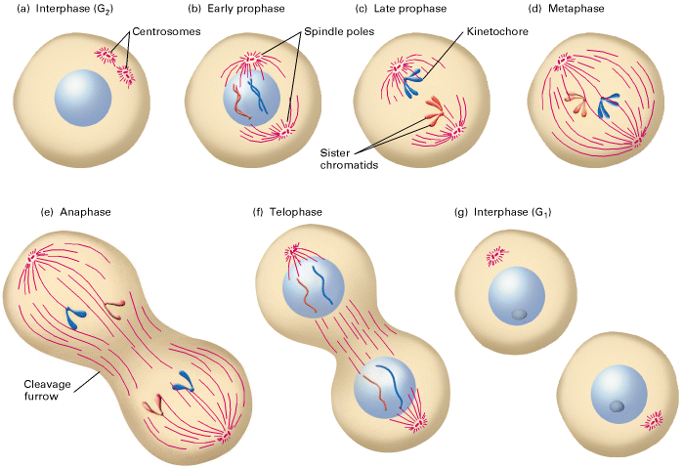

Slide 14
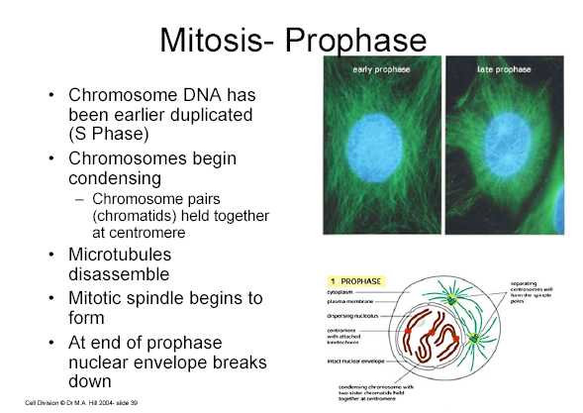

Slide 15
Prophase
Condensation of chromosomes.
Critical in enabling the movement along the mitotic spindle.
Mediated by phosphorylation of core histone H3 through interaction with the codensin complex.
The codensin-complex results from interaction of AKAP95 (A-kinase anchoring protein), PKA (cAMP-dependent protein kinase) and EG 7; A 150 KD inductive nuclear protein.

Slide 16
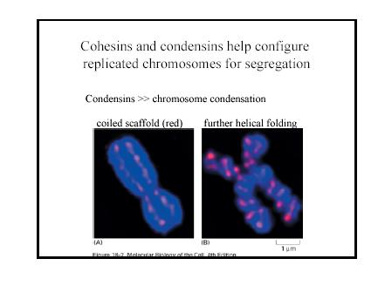

Slide 17
Prophase
Cytoplasmic changes leading to the development of the mitotic spindle by selective stablization of interacting microtubules.
Nucleolus disintegrates and the nuclear membranes dissolves.
Induced by MPF (promoting factor) and cdc 2 phosphorylation of nuclear lamina and golgi matrix protein (GM130).

Slide 18
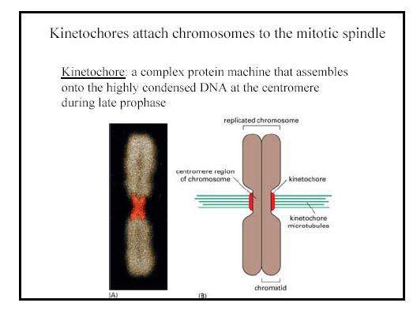

Slide 19
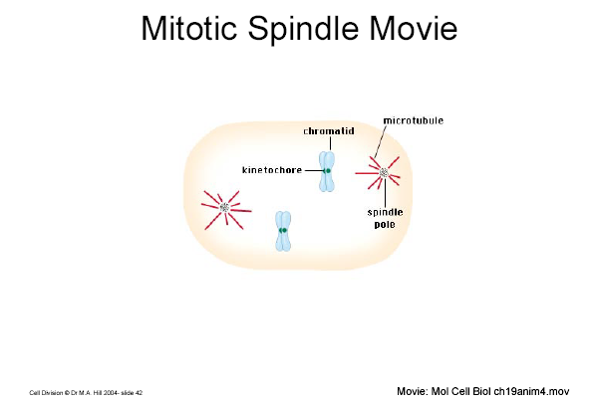

Slide 20
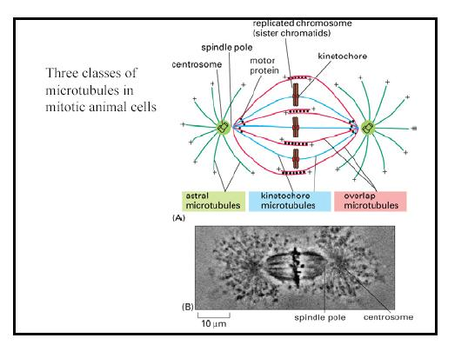

Slide 21
Metaphase
Chromosomes arranges in the plane of the spindle equator- the equatorial /metaphase plate.
Each chromosone divides longitudinally to form the sister chromatids.
The kinetochore controls entry into anaphase so that the process of mitosis does not progress until all chromatid pairs are aligned at the cell equator.
This metaphase check point prevents the formation of daughter cells with unequal number of chromosomes.

Slide 22
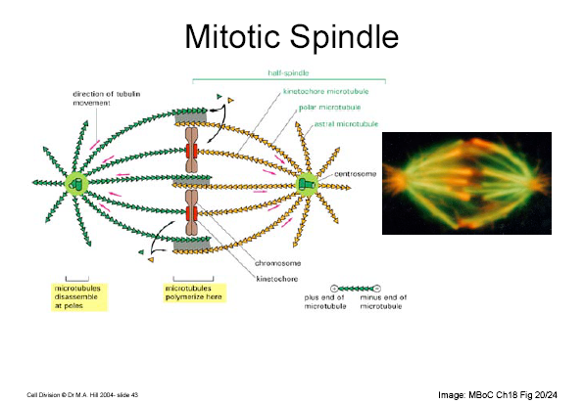

Slide 23
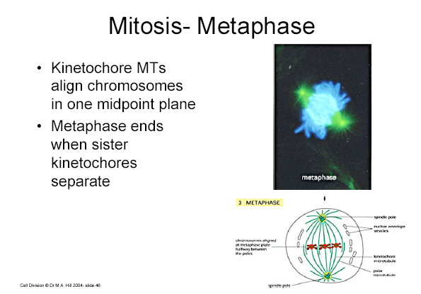

Slide 24
Anaphase
Marked by splitting of the centromere and the pulling of the chromosomes to opposite poles of the spindle.
Progression from metaphase to anaphase results from activation of anaphase-promoting complex (cyclosome) (APC/c) which remains inhibited until a cell passes the metaphase check point.

Slide 25
Anaphase
APC/c triggers the events leading to;
Destruction of cohesins ; allows separation of sister chromatids.
Degradation of the mitotic cyclin B which leads to inactivation of m-promoting factor.
Divided into anaphase-a and anaphase- B.

Slide 26
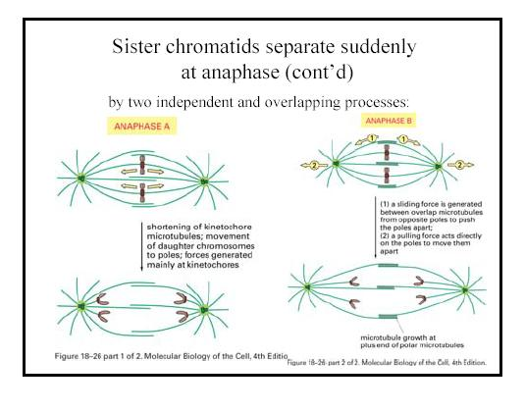

Slide 27
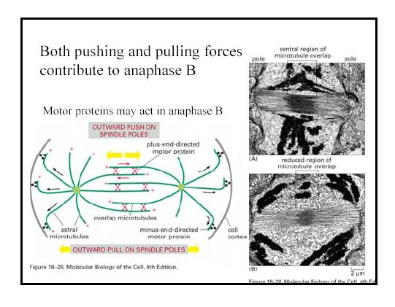

Slide 28
Telophase
Chromosomes uncoil to regain their interphase conformation.
Nuclear envelope reassembles. Nucleolus becomes apparent.
Cytokinesis also takes place during telophase.

Slide 29
Telophase
Inactivation of MPF and dephosphorylation of proteins that it had phosphorylated leads to nuclear, microtubules and membrane changes that characterize the end of m-phase.
Cytokinesis is mediated by a contractile ring of actin and myosin II filaments beneath the plasma membrane at the position of the mitotic spindle.

Slide 30
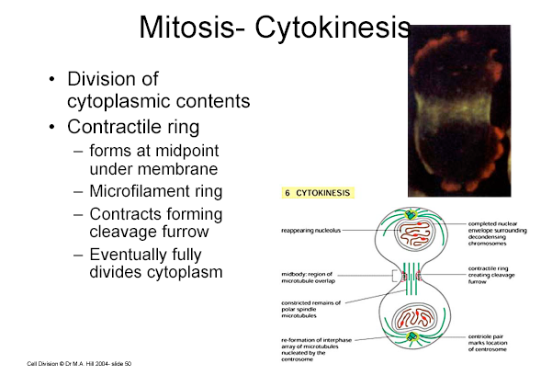

Slide 31
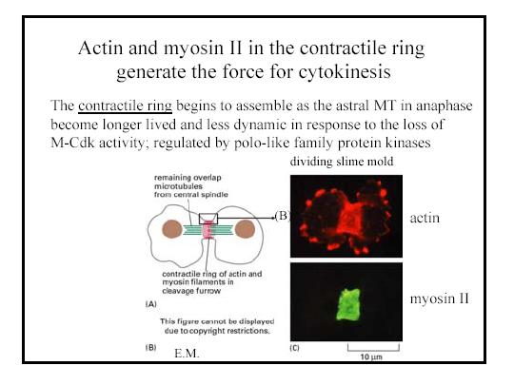

Slide 32
Interphase
Time between successive mitosis.
Gap 1 phase (presynthesis).
Period of cell growth, DNA and protein synthesis in preparation for next division or specialized function.
During this time, the cell monitors it’s environment and it’s own size then decides the appropriate time to enter S-phase.
Most variables cycle period time-wise among different type of cells.
Can end in Go-phase.

Slide 33
Interphase
Synthetic phase (S/ DNA synthesis phase).
Synthesis and replication of DNA.
Duplication of the centrosomes with their centrioles.
Gap 2 phase.
Period between the end of DNA replication and mitosis.

Slide 34
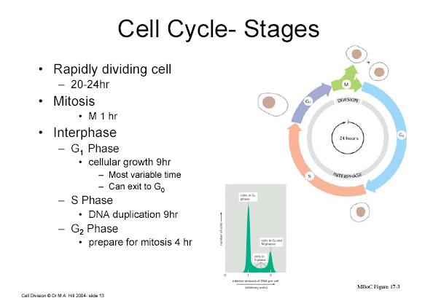

Slide 35
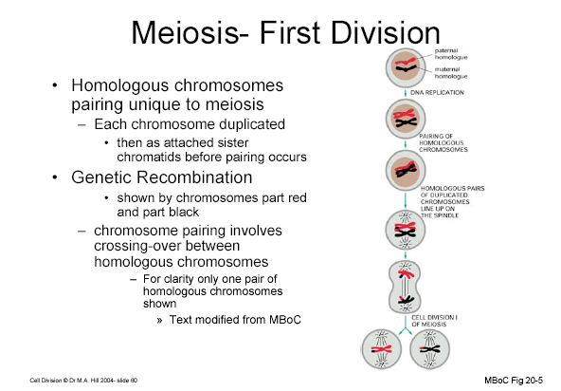

Slide 36
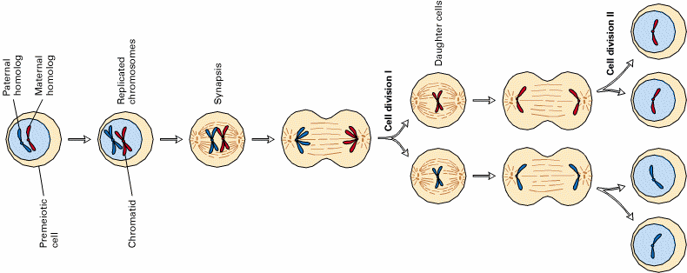

Slide 37
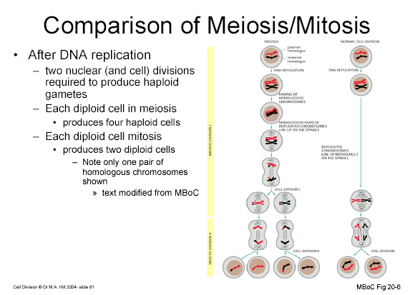

Slide 38
Control of the Cell Cycle
Passage of a cell through the cycle is controlled by cytoplasmic proteins called cyclins.
Cyclins.
  G1 cyclin (cyclin D).
  S-phase cyclin (cyclins E and A).
  Mitotic cyclins (cyclins B and A).
Their levels in the cell rise and fall with the stages of the cell cycle.

Slide 39
Control of the Cell Cycle
Cyclin- dependent kinases (cdks).
  A G1 cdk (cdk4).
  An S-phase cdk (cdk2).
  An M-phase cdk (cdk1).
Their levels in the cell remain fairly stable but must bind the appropriate cyclin (whose levels fluctuate) in order to be activated.
They add phosphate groups to a variety of protein substrates that control processes in the cell cycle.
A rising level of G1 cyclin bind to their cdks and signal the cell to prepare the chromosomes for replication.

Slide 40
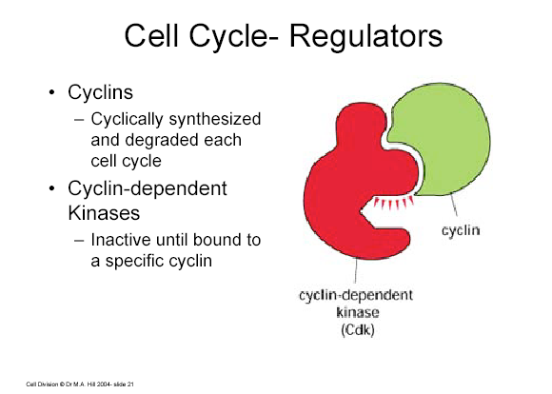

Slide 41
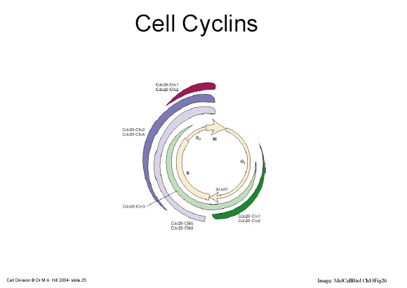

Slide 42
Control of Cell Cycle
S-phase promoting factor (SPF).
Includes cyclin A bound to cdk2.
Enters nucleus and prepares the cell to duplicate it’s DNA(and it’s cetrosomes).
As DNA replication continues, cyclin E is destroyed and the level of mitotic cyclins begins to rise (in G2).

Slide 43
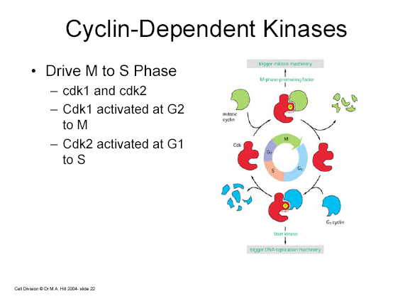

Slide 44
Control of Cell Cycle
M-phase promoting factor.
Complex of mitotic cyclins and m-phase cdk’s that leads to;
Assemblyof spindle.
Breakdown of nuclear envelope.
(Initiates) the condensation of chromosomes.

Slide 45
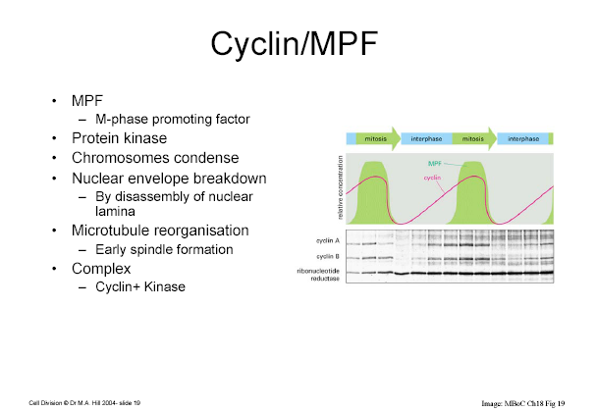

Slide 46
Control of Cell Cycle
Anaphase-promoting complex (cyclosome) (APC/c).
Activated by the MPF.
Triggers destruction of cohesins.
Degrades cyclin B by attaching to the protein ubiquitin which targets it for destruction by proteasomes.
Turns on synthesis of G1 cyclin, growth factors and stimulates cell division.

Slide 47
Checkpoints
Systems for interrupting the cell cycle if something goes wrong ie quality control of the cell cycle.
A check in completion of S-phase (Okazaki fragments).
DNA damages check-points.
G1 check-point:; Before entry into S-phase.
During S phase.
G2 checkpoint: after DNA replication.

Slide 48
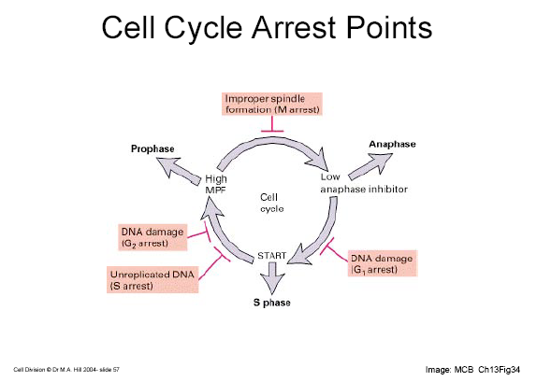

Slide 49
Checkpoints
Spindle check points.
Metaphase checkpoint ; kinetochore/spidle fibres attachment and polarity.
Triggers apoptosis if damage is irreparable.
All the checkpoints require the services of proteins coded by proto-oncogenes.
Mutation of these genes –oncogenes- results in various types of cancers.

Slide 50
Proto-oncogenes
P53/ tumour suppressor gene : G1 arrest in case of repairable DNA damage ; promotes apoptosis in severe DNA damage.
More than half of all human cancers harbour p53 mutations and have no functioning p53 protein.
ONYX-015 therapeutic trial.
Retinoblastoma protein (Rb) : first oncoprotein to be identified in children with hereditary retinoblastoma.
Subsequently found to be functionally inactivated in several other human tumour types.

Slide 51
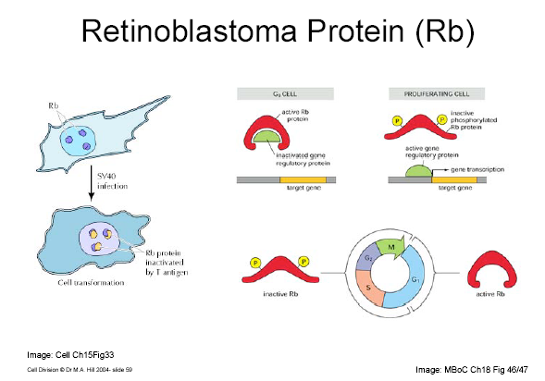

Slide 52
Proto-oncogenes
Ataxia Telengiectasia mutated (ATM); Human disease of that name with increased risks to cancers.
Detects DNA damage and interrupts the cell cycle (with p53) when one is found.
Mitotic arrest deficient (MAD) genes;
Enforces mitotic arrest and prevents aneuploidy.
Encodes proteins that bind to each kinetochore until a spindle fiber attaches to it.
If there is any failure to attach,mad remains and blocks entry into anaphase.
P27; Blocks entry into s-phase.Breast cancer prognosis.

Slide 53
Programmed Cell Death
Normal physiological form of cell death.
5x10” blood cells per day.
Virus infected cells.
Tumor cells.

Slide 54
Programmed Cell Death
Active process.
Physlogical events that together are called apoptosis.
Chromosomal DNA cleavage.
Cell shrinkage and breakage into membrane enclosed vesicles-apoptotic bodies.

Slide 55
Programmed Cell Death
Regulators and effectors.
Negatively (avoided) by members of the Bcl-2 family of proteins.
Positively by tumour suppressor genes.

